Slide 1
AU LONDON 2019
Ben Robinson
How to Build GUI Nodes for Dynamo Using Python

Slide 2

About the speaker
Computation BIM Designer: Hawkins\Brown
2014 3D Print Designer in Amsterdam
2015 Graduated from the Manchester School of Architecture. Joined Hawkins\Brown as an architectural assistant
2018 Qualified as an Architect and moved into a full time role as a digital designer Within HB\Technologies.

Slide 3


Thomas Mahon, BiMorph
Alex Faur , Fabrit Global

Slide 4

Hawkins\Brown
Offices
London
Manchester
Los Angeles
Edinburgh
Staff
>270(ish)

Slide 5
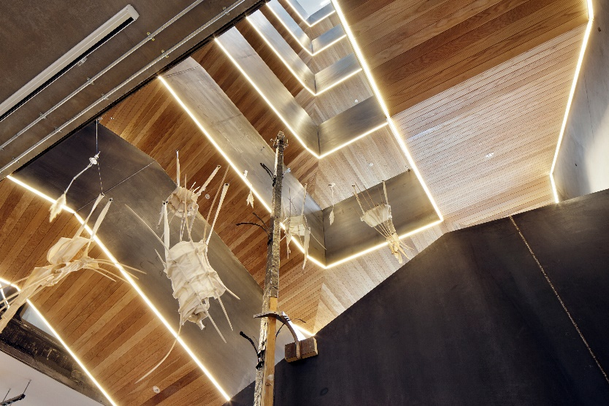


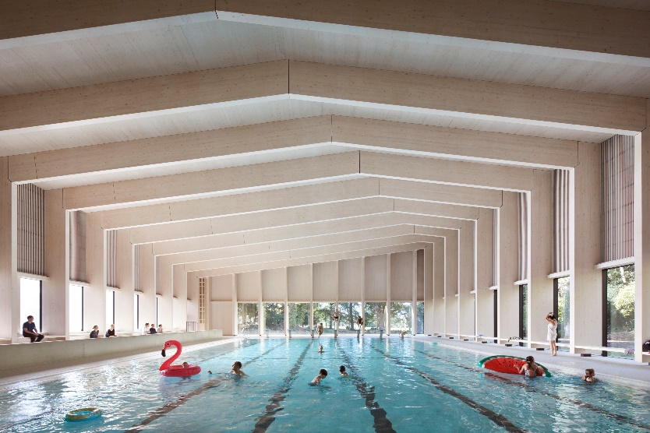
What We Do

Slide 6
A small caveat…. I am not a trained programmer
I have self taught Dynamo/Python/C#
If you see any code \ termonology that could be improved, please let me know (I will not be offended)

Slide 7
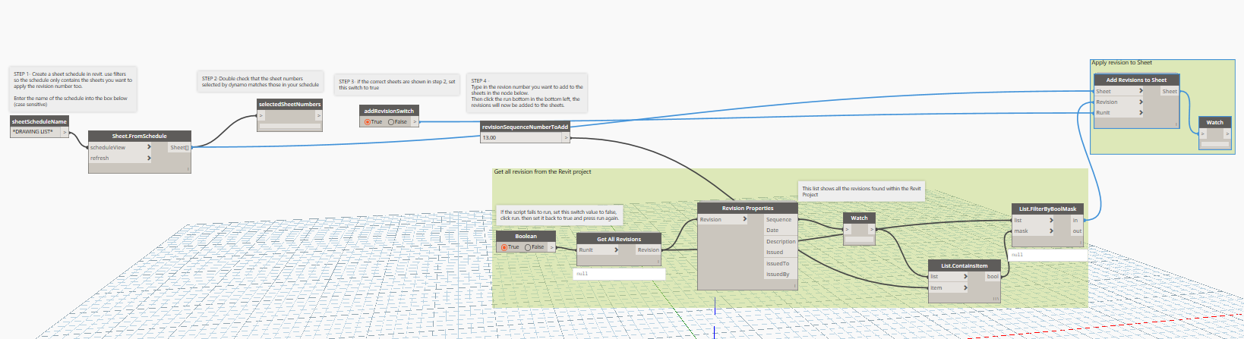
Why Build User Interfaces?
Getting users past the Dynamo fear factor
We have found that integrating GUI into our scripts have greatly increased the number of times they are used, particularly from users with no experience of Dynamo

Slide 8
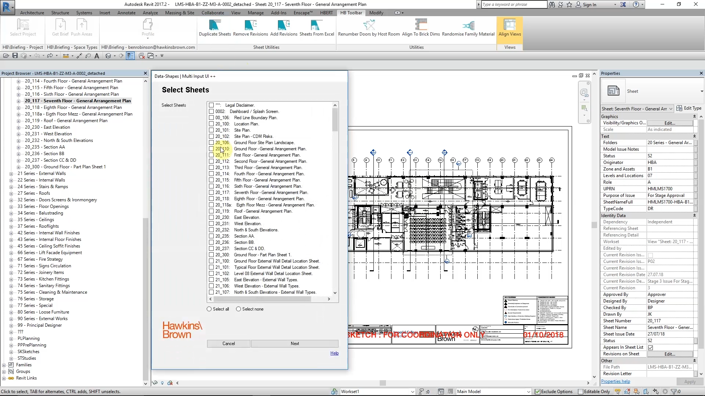

Slide 9
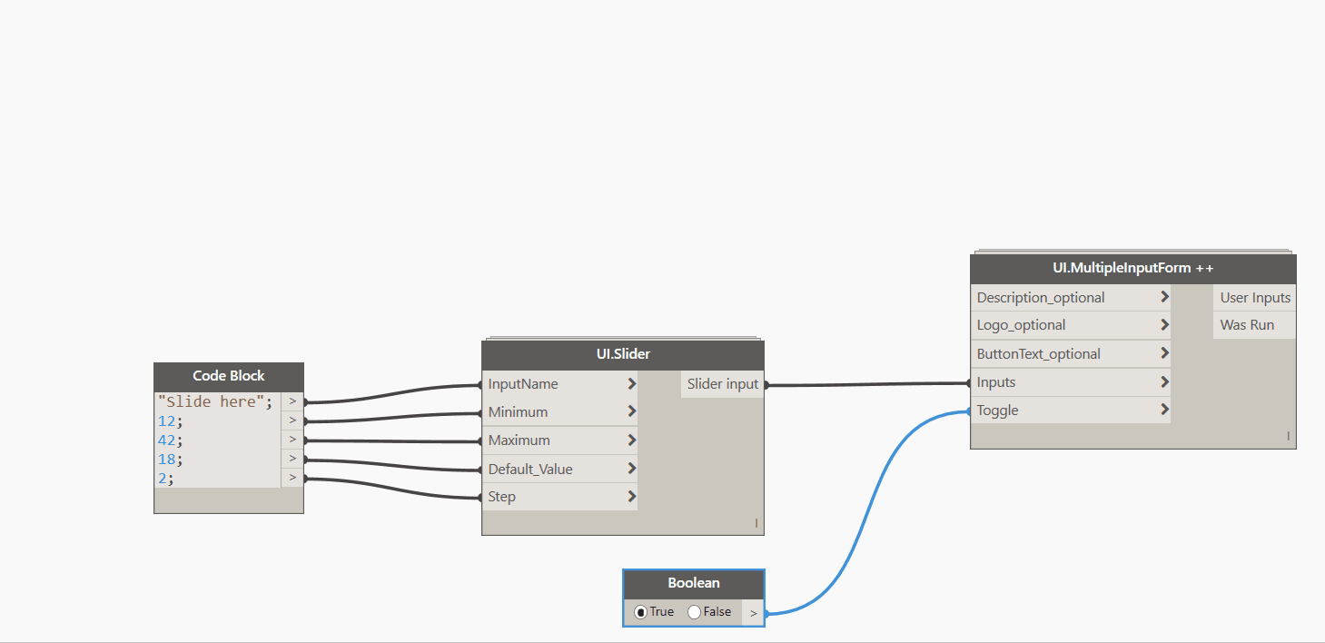
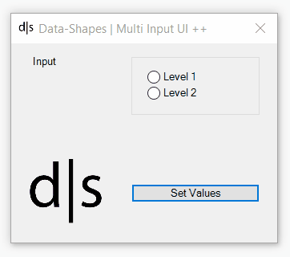
Out of the box GUI: Data-Shapes
Currently the only package offering out of the box GUI’s.
Amazing package from a great team! Visit their website for guides on how to use their package
https://data-shapes.io/

Slide 10
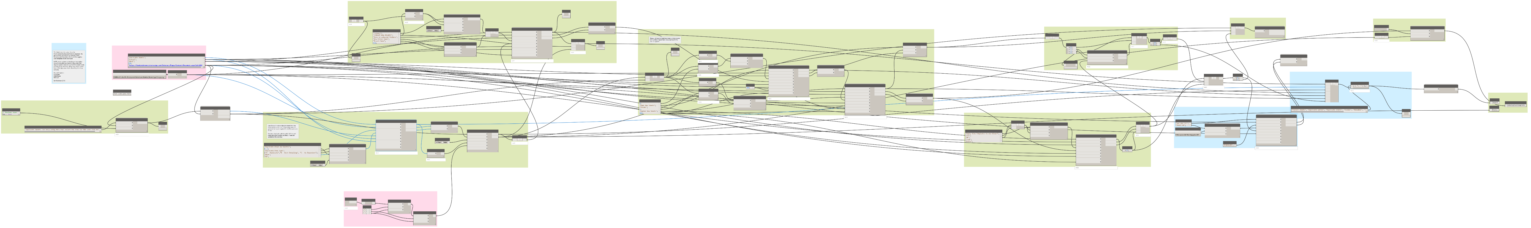
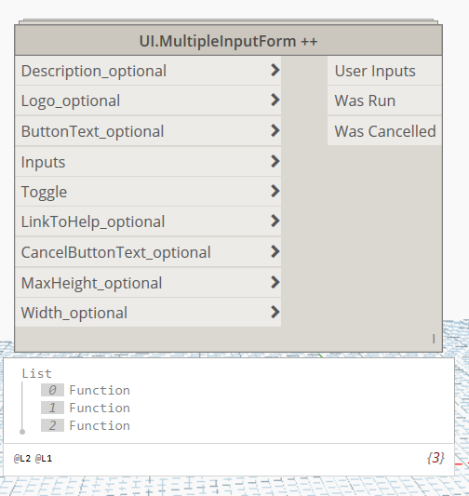
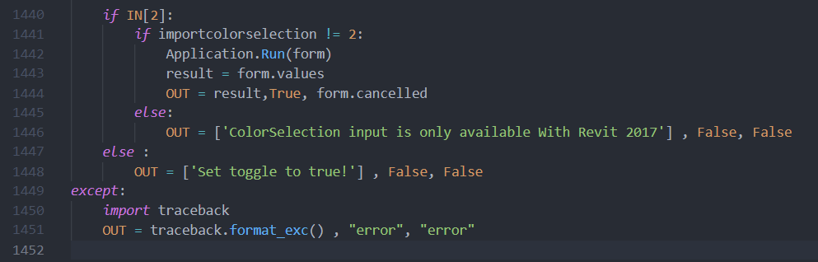
A minor negative
Integrating their GUI nodes balloons your graph size, Multiple nodes needed for each GUI
Nodes are very complex (1400 lines of code) so difficult to learn from or adapt

Slide 11
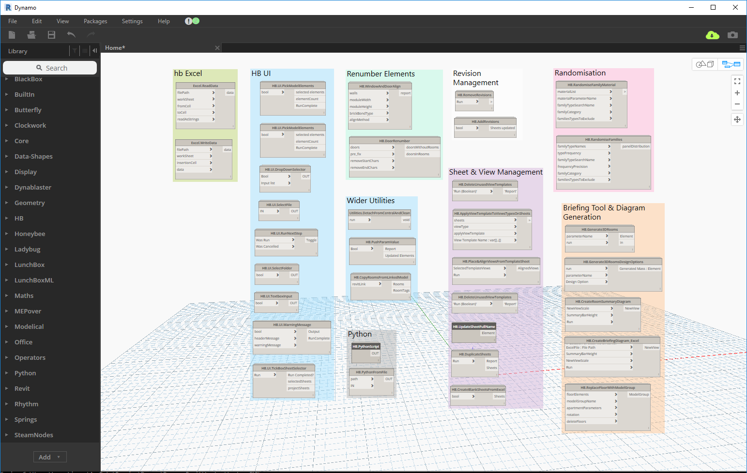

Slide 12
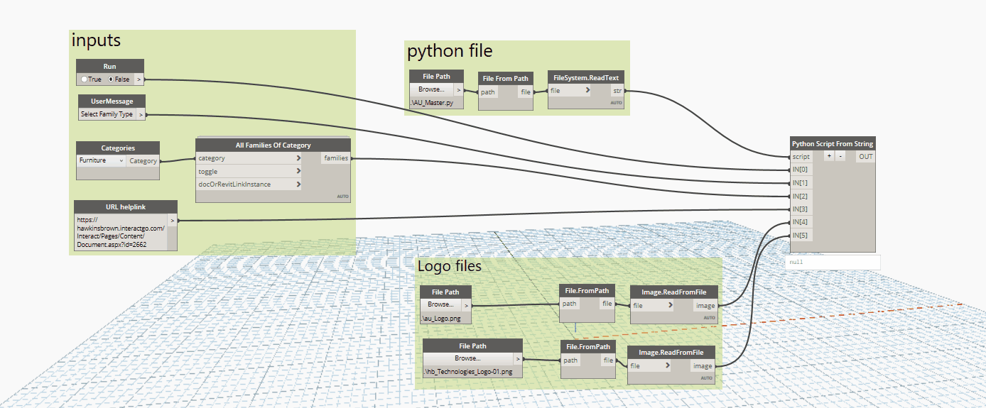
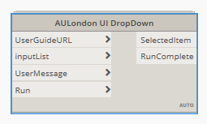
What we will achieve today
Notes:
130 is lines of code

Slide 13
Key Resources
Zetcode.com
Voidspace.org
Step by step instructions on building some WinForms in Iron Python
http://zetcode.com/tutorials/ironpythontutorial/introduction/
Similar to Zetcode, with a few more methods and controls covered
http://www.voidspace.org.uk/ironpython/winforms/index.shtml
Microsoft WinForms documentation
Dynamo Forum
The full documentation of WinForms. Examples of all available methods etc. Written in C# https://docs.microsoft.com/en-us/dotnet/api/system.windows.forms.form?view=netframework-4.8
Its not a popular topic, but there are a lot of people on the forum including myself and the Data-Shapes team that can help https://forum.dynamobim.com/search?q=winform

Slide 14
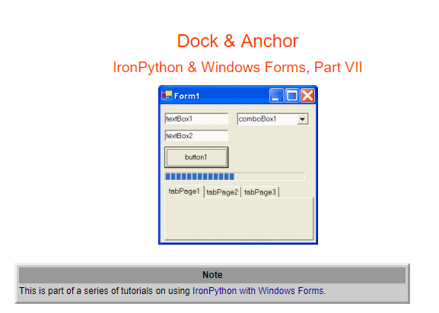
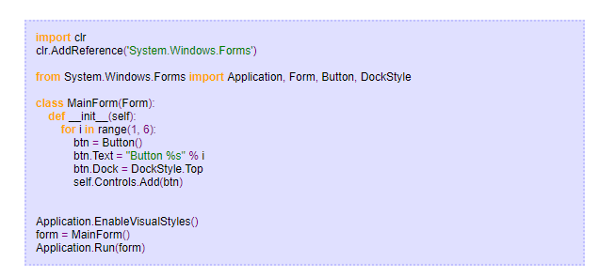
Zetcode.com

Slide 15
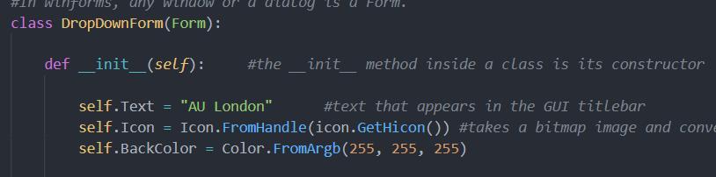
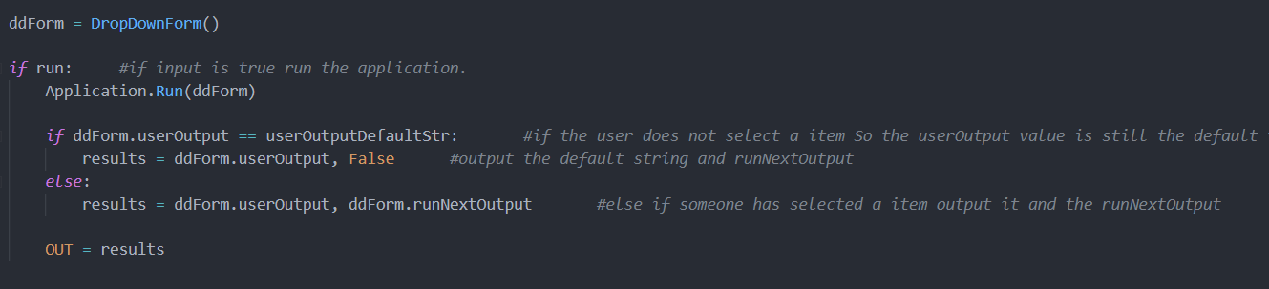
Key Terminology
Class & Object
A blueprint created by a programmer for an object. This defines a set of attributes that will characterize any object that is instantiated from this class.
An Object is simple an instance of a class

Slide 16
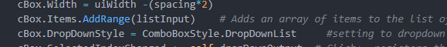
Key Terminology
Method & Property
Similar to a function, it called by its name (Always a capital Letter), but it is implicitly associated with an object/class.
https://docs.microsoft.com/en-us/dotnet/api/system.windows.forms.control.controlcollection.addrange?view=netframework-4.8
Properties : controllable attributes of an object

Slide 17
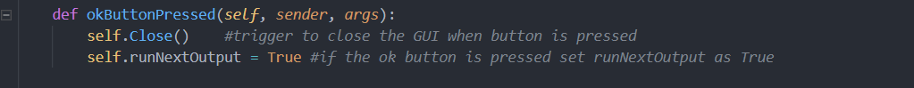
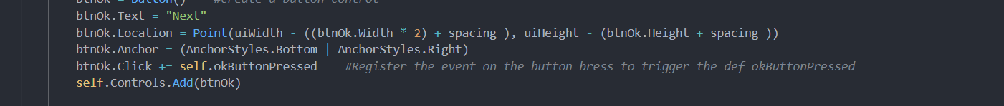
Key Terminology
Function & Definition
A function is a block of organized, reusable code that is used to perform a single, related action. Functions provide better modularity for your application and a high degree of code reusing
A definition Is simple a user defined function

Slide 18
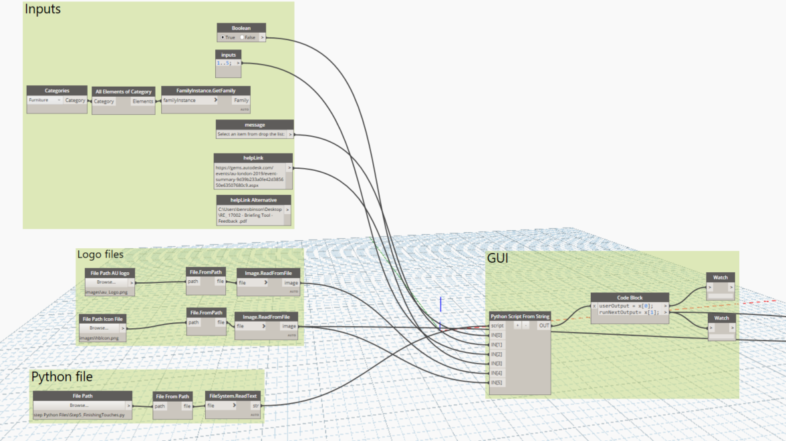
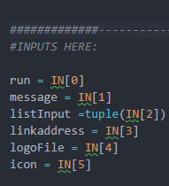
Dynamo Setup
Notes:
List input must be a tuple. Which is similar to a list but it cannot be changed. I have not been able to find out why it has to be a tuple input.

Slide 19
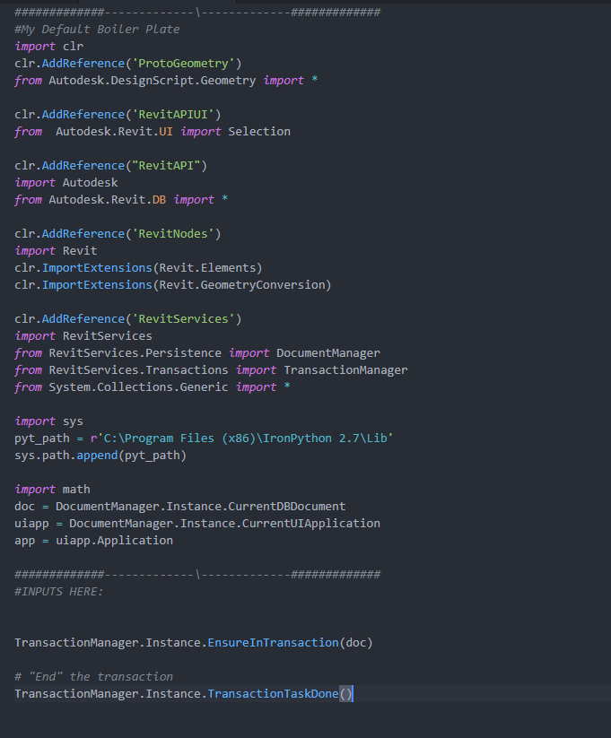
1: The Boiler Plate & Inputs
A Boiler plate is essentially code that can be reused without context in new applications
Not all references are required to build a standalone GUI
I keep them incase I will need them further down the line.
Then delete unused when imports when it is finished
Notes:
This is my default boiler plate, that includes all the references etc. I would typically need in dynamo.
In this case we will not need many of them to create the UI itself. But if you wanted to add additional functionality down the line,
In this case we will not be starting a transaction with the revit doc so just delete this

Slide 20
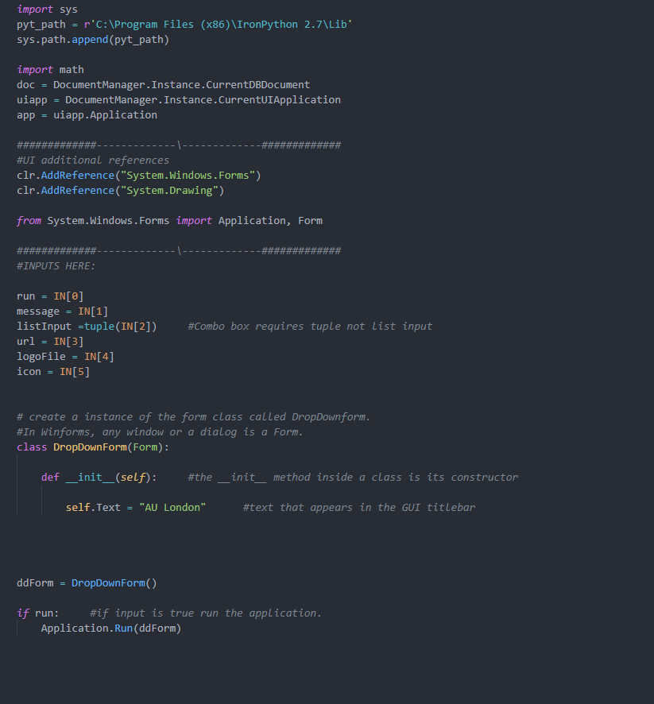
2: Hello World GUI
1: Add the WinForms and drawing assemblies
2: import the individual references we need now
3: For the main form create a class called “DropDownForm” this will use the Form class to create our GUI
4: __init__“ is a constructor in Python classes. Its called to create the GUI object and initiate the forms attributes
5: self represents the instance of the class. By using the "self" keyword we can access the attributes and methods of the class such as .Text which sets the title of the GUI
6: Create an instance of our DropDownForm() class
7: Run the application
1
2
3
4
5
6
7
Notes:
The Application Class :
Provides static methods and properties to manage an application, such as methods to start and stop an application...
The Run static method :
starts an application message loop on the current thread and, optionally, makes a form visible.

Slide 21
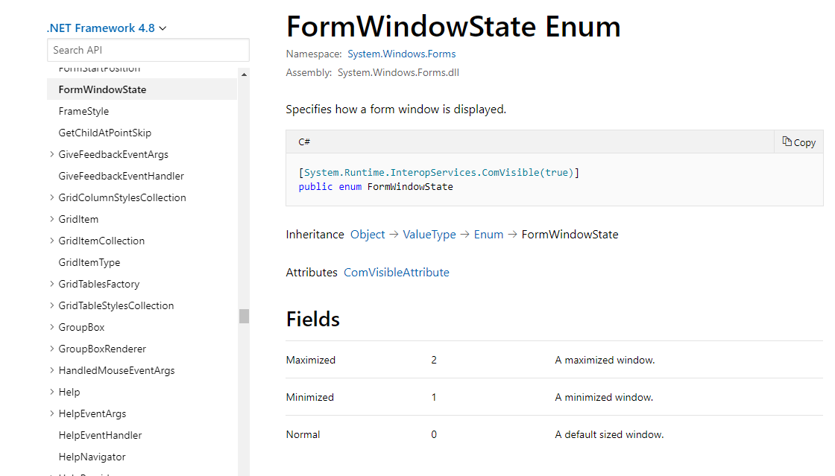
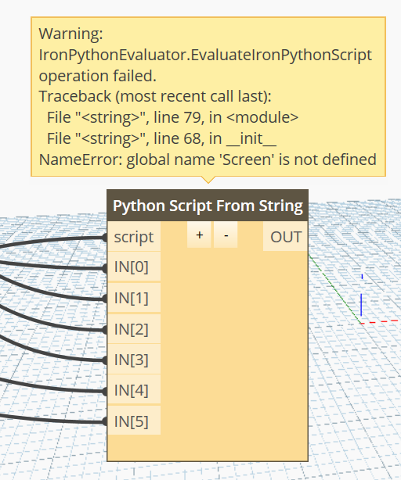
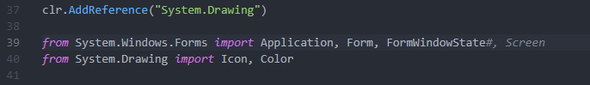
Tip 1
Tip 2
To find a list of all properties and methods of the Form Class check the below documentation
https://docs.microsoft.com/en-us/dotnet/api/system.windows.forms.form?view=netframework-4.8
If you use a control and get the above error it will be because you have not imported the control from Windows.Forms
Notes:
Tip 1: There will be plenty of classes / methods etc today that you will not be aware of. Don’t worry neither did I, If you take this further just check the documentation to learn more about each of these.
Tip”, the most likely error you will get today is …. This will be because you havnt imported the particular form.

Slide 22
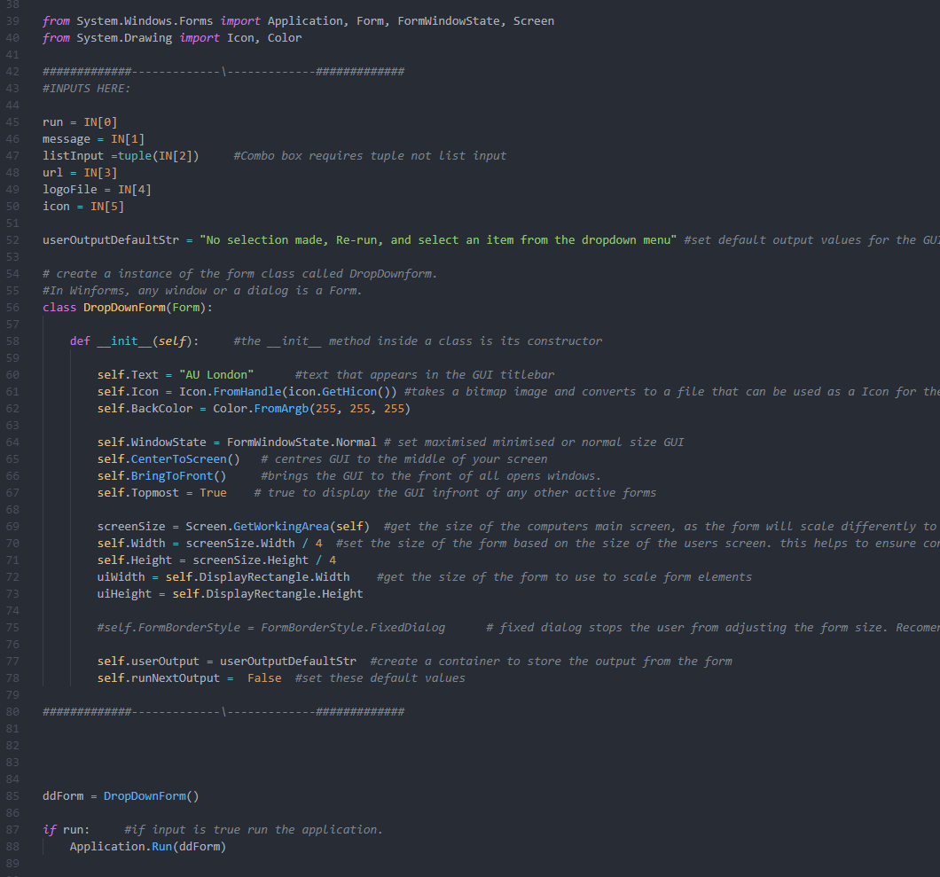
3: Basic Form Controls
1
1: GUI require widgets/controls: ways of receiving inputs (buttons etc.) When we use any control it must be imported.
2: Get a bitmap image from at the input path and use it as the GUI icon
3: These methods ensure the GUI comes to the front your screen and is scaled normally
4: Get the size of the user's screen and make the GUI ¼ dimension of the screen.
5: FormBorderStyle = FormBorderStyle.FixedDialog stops the form from being scaled in size by a user. Disable this for testing incase controls disappear
6: Create 2 output values to store the values of the item selected and run control
6
2
3
4
5
6
Notes:
Default string needs to be declared outside of the definition
From Handle returns the control that is associated with the handle which is the window the icon is displayed in.
Windows handle to an icon with the same image as the Bitmap.

Slide 23
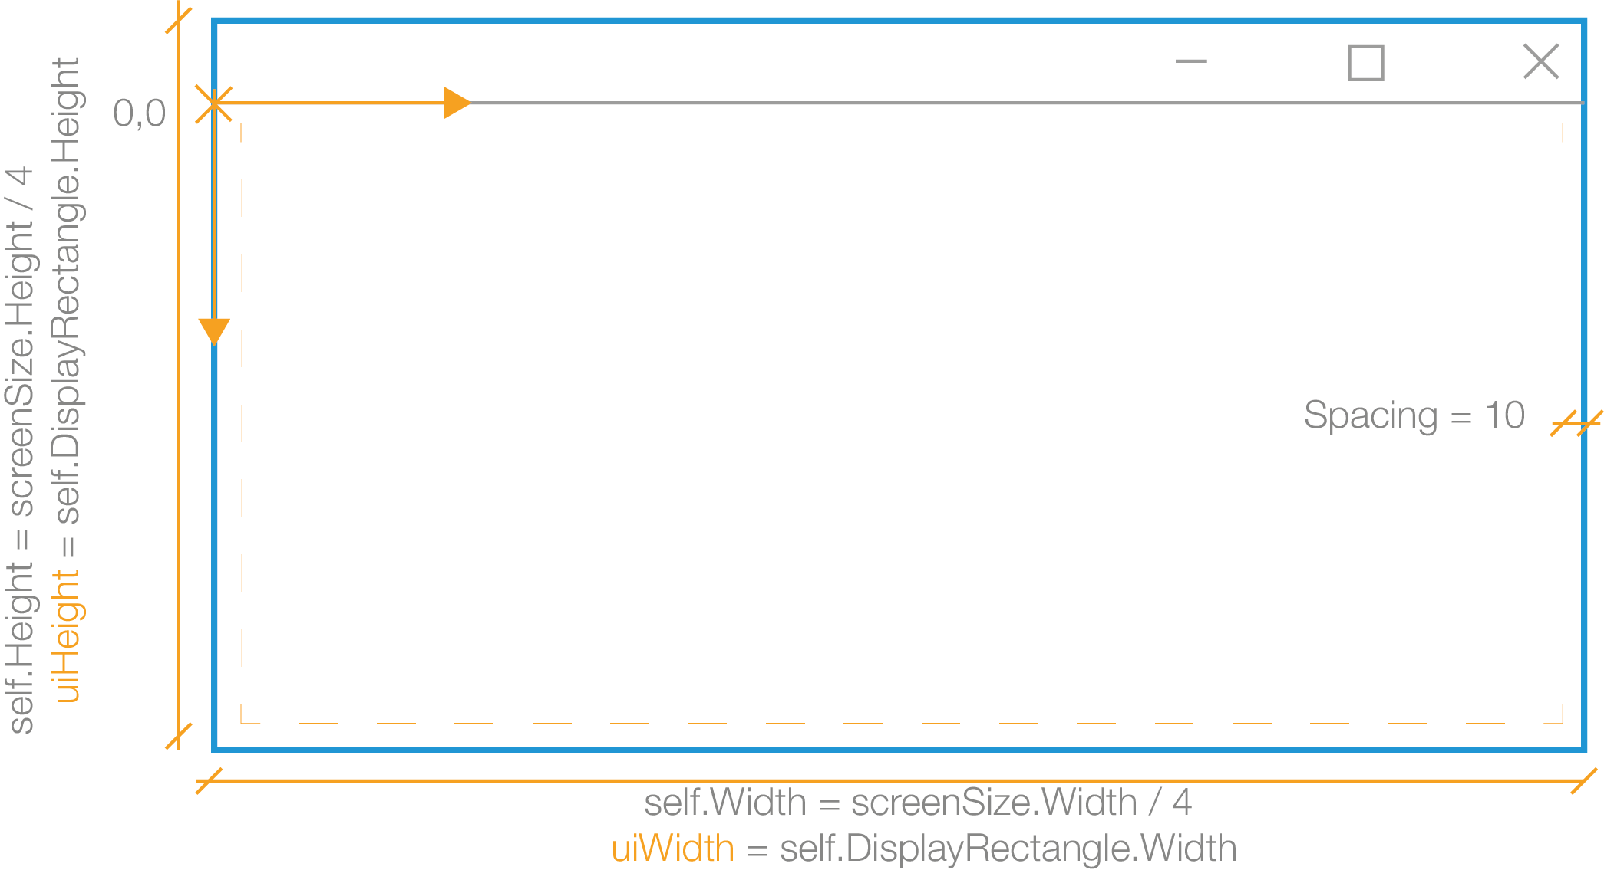
Setting out the GUI Controls
Notes:
Tip 1: Check the Microsoft documentation

Slide 24
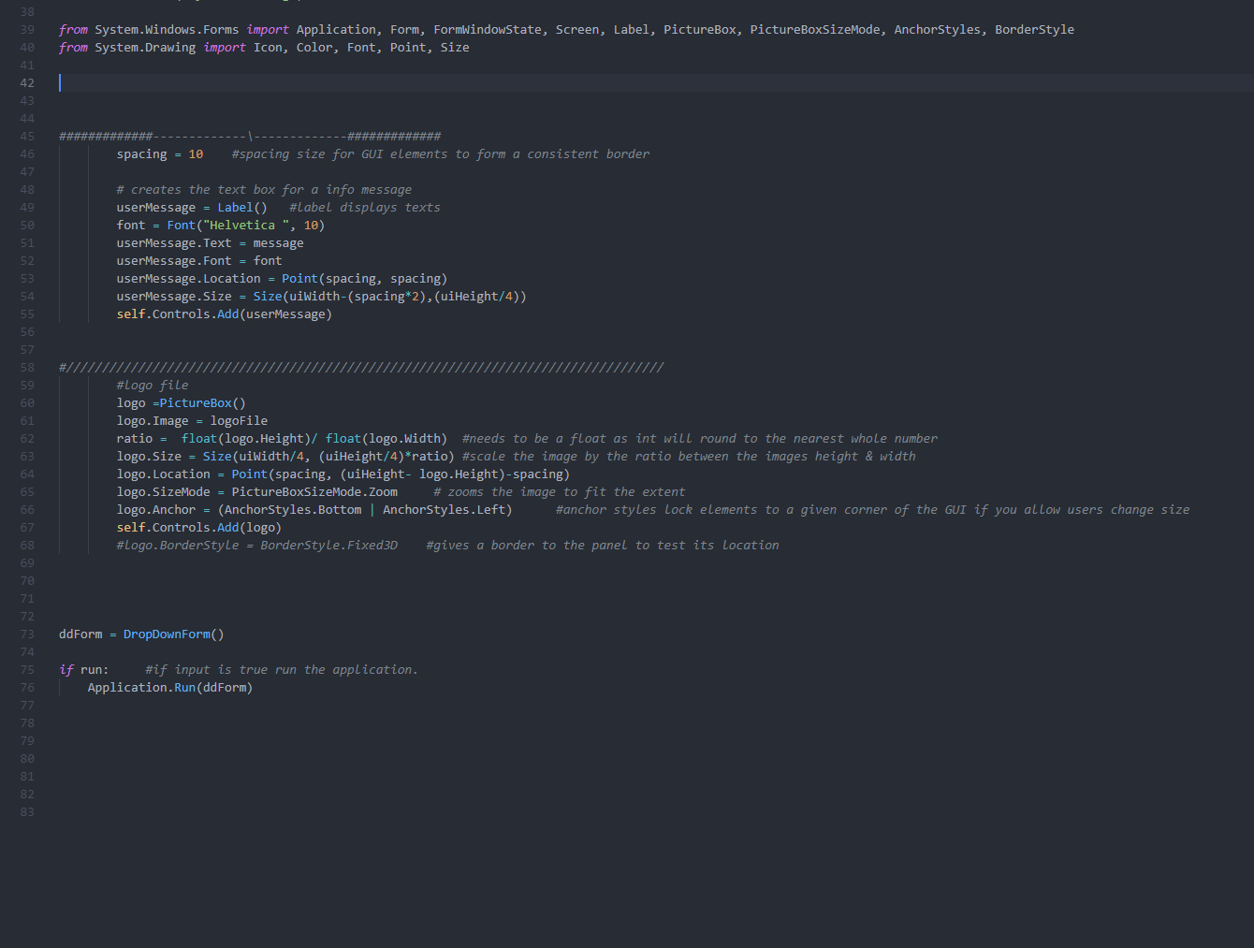
4: Adding Simple Controls
1: The label control allows text to be added to the GUI .
2: Point object is required in order to location a control (X,Y)
3: Size the label using uiWidth + uiHeight. This ensures is scales will the GUI for different type screens.
4: self.Controls.Add() Adds the control to the GUI
5: Get the ratio of logo height to width. Value must be a float as an int will round to the nearest 1.
6: SizeMode scale the image to fit the input size.
7: AnchorStyles lock the control to a given corner(s) this is needed if the user can change the size of the GUI
1
2
3
4
5
6
7
Notes:
Default string needs to be declared outside of the definition

Slide 25
Setting out the GUI Controls
userMessage

Slide 26
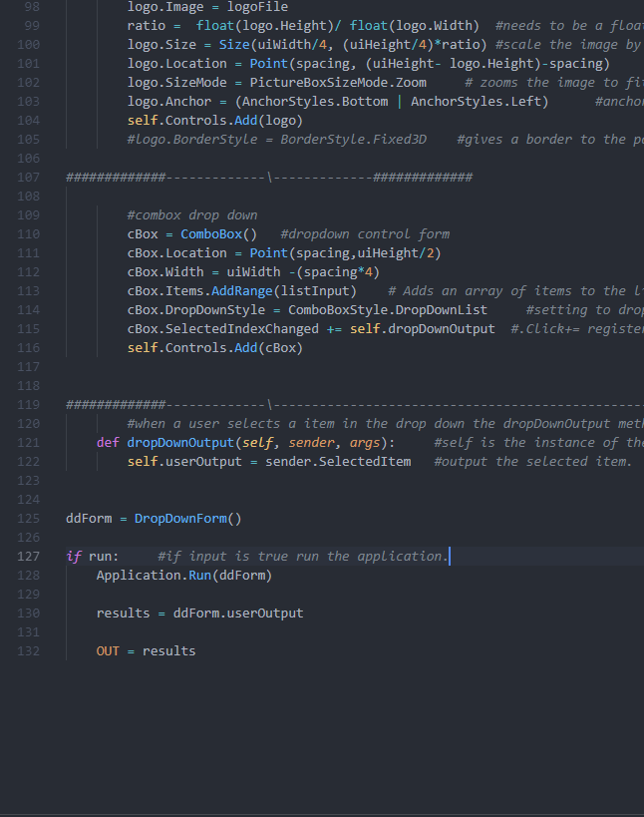
5: ComboBox Control
1: ComboBox is a drop down and text input control
2: Add a list of items for the drop down using .AddRange()
3: ComboBoxStyle.DropDownList remove the ability for a user to input a text value into the control
4: SelectedIndexChanged+= registers the event handler of the user selecting an item from the control to then run the def dropDownOutput
5: self = instance of the form class (dropDownOutput) sender = the control object sending that raised the event Args = the argument/event from the sender assign the select item to userOutput variable
6: assign the output of ddForm.userOutput to results and output it
1
2
3
4
5
6
Notes:
A Class is like an object constructor, or a "blueprint" for creating objects.
The Application Class :
Provides static methods and properties to manage an application, such as methods to start and stop an application...
The Run static method :
starts an application message loop on the current thread and, optionally, makes a form visible.

Slide 27
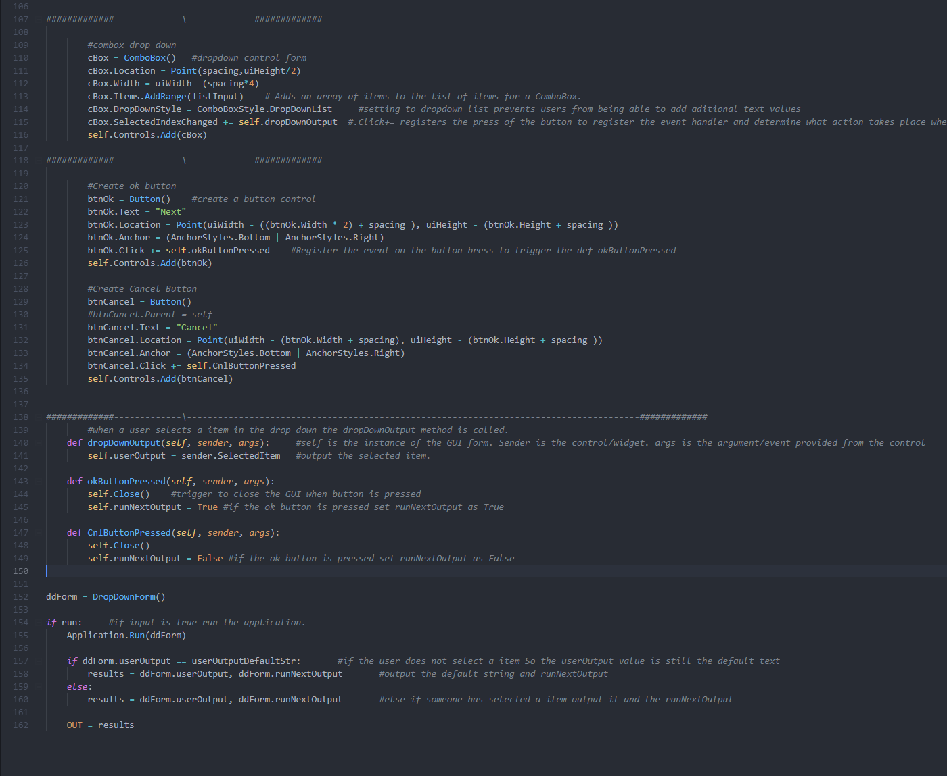
6: Button Controls
4
1: Create a button control called btnOk
2: when the button is clicked register the event to run the def okButtonPressed
3: when the button is pressed close the form and set the runNextOutput variable btnOk = True, btnCancel = False
4: default values created act as output control. So if a user selects an item from the dropdown but does not press the next button the runNextOutput variable will return False.
5: User must select an item and click the btnOk to output the select item and True.
1
2
3
4
5
Notes:
A Class is like an object constructor, or a "blueprint" for creating objects.
The Application Class :
Provides static methods and properties to manage an application, such as methods to start and stop an application...
The Run static method :
starts an application message loop on the current thread and, optionally, makes a form visible.

Slide 28
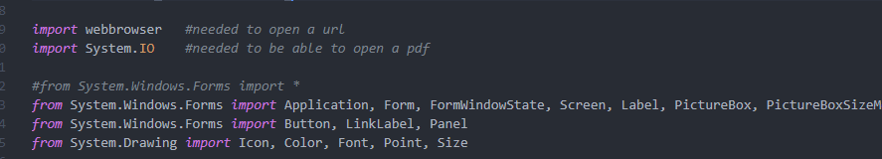
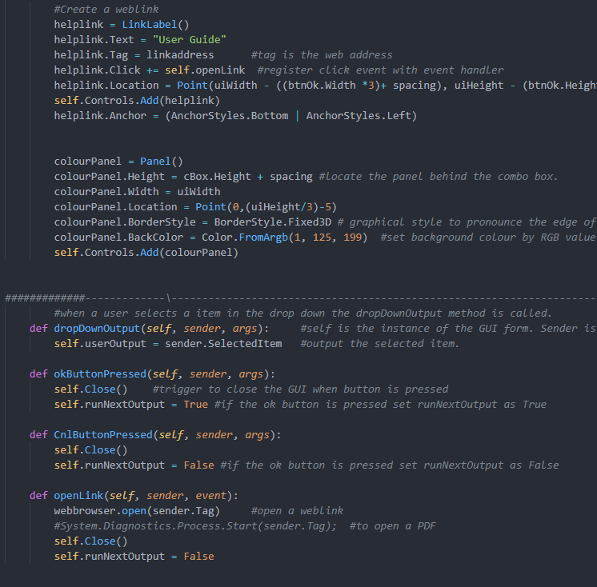
6: Finishing Touches
1: Create a linkLabel control: A button which activates a link
2: link is assigned to helpLink.Tag
3: when the link is pressed the event is logged to run the def openLink
4: Create a Panel. It’s meant for grouping but can be used for colour
5: Sets its colour using the FromArgb method and set the border style to fixed 3D
6: If the link is a weblink you need webbrowser.Open() if it’s a pdf etc you need System.Diagnostics.Process…… Don’t forget the additional import references!
1
2
3
4
5
6

Slide 29
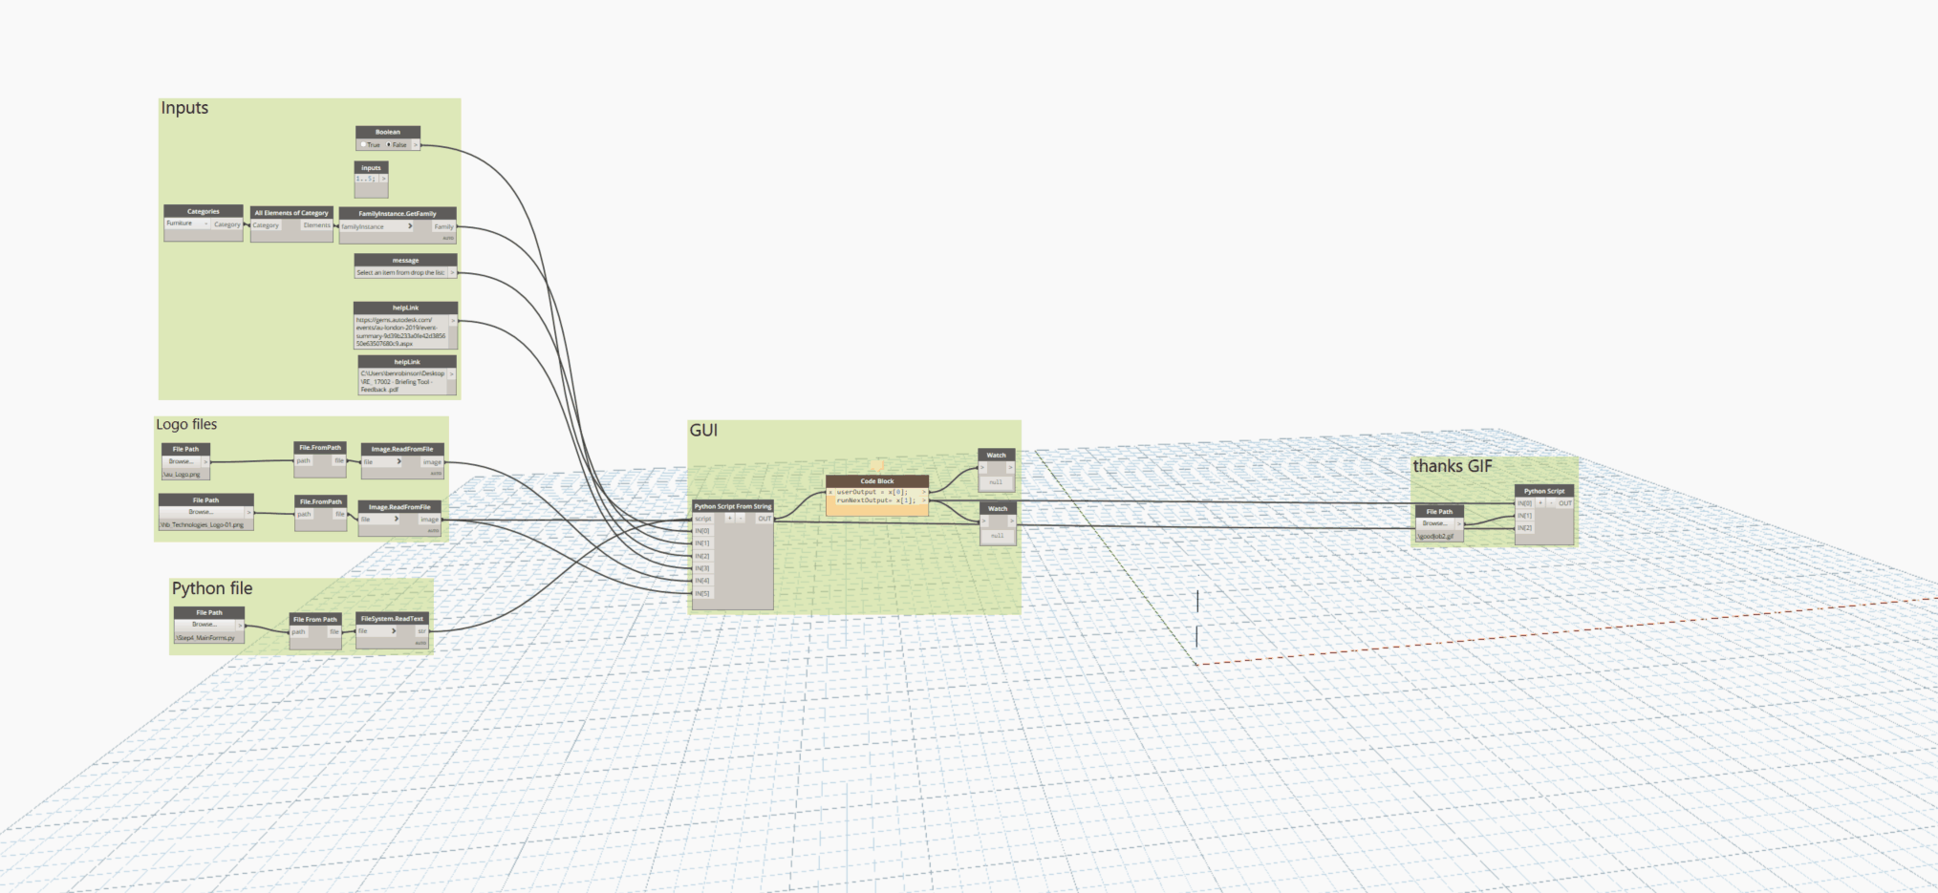
Final Output
Notes:
Using visual code,
Linke with github, intelisense already better than the Dynamo python console.

Slide 30
Thank you!
https://github.com/benrobinson20
https://twitter.com/Robinson00Ben
https://www.linkedin.com/in/ben-robinson-233138b/

Slide 31
Autodesk and the Autodesk logo are registered trademarks or trademarks of Autodesk, Inc., and/or its subsidiaries and/or affiliates in the USA and/or other countries. All other brand names, product names, or trademarks belong to their respective holders. Autodesk reserves the right to alter product and services offerings, and specifications and pricing at any time without notice, and is not responsible for typographical or graphical errors that may appear in this document.
© 2019 Autodesk. All rights reserved.

